Slide 1
2025 Visitor Site Induction
Notes:
Image can be changed. Click on image box and delete. It will be replaced with an image place holder to add your image. Don’t use the “Change image” option as this will alter the size of the image box. Choose “Send to Back” once done so that logos & graphics are in the foreground.

Slide 2
Your responsibilities
Avoid causing harm or injury to others through your actions
Follow safety instructions provided by Capral—ask questions if you're unsure.
Report hazards, injuries, or illnesses to your Capral Representative
Cooperate with Capral to ensure a safe workplace.
Notes:
If this slide doesn’t have a lot of copy use the alternative layout option that has a graphic element on the bottom right corner.

Slide 3
Capral’s Responsibilities
Maintain safe workplaces, equipment, and work systems to protect everyone from hazards.
Provide clear information about hazards and risks related to your job.
Offer induction and supervision to help you work safely.
Consult and cooperate with safety representatives and employees on health and safety matters.
Notes:
If this slide doesn’t have a lot of copy use the alternative layout option that has a graphic element on the bottom right corner.

Slide 4
Standards of Conduct
Capral is committed to a fair, respectful, and safe workplace, free from discrimination, harassment, and bullying. All visitors must:
Treat others with respect and value differences.
Avoid discrimination, harassment, or bullying.
Report inappropriate behaviour to Capral
Notes:
If this slide doesn’t have a lot of copy use the alternative layout option that has a graphic element on the bottom right corner.

Slide 5
Prohibited items
Prohibited/ Banned items in Capral Extrusion Manufacturing facilities (Can be consumed in lunchroom only)
Aluminium Cans
Glass Bottles
Aluminium Containers
Cigarette Lighters
Non-registered spray cans
WHY?
Risk of explosion (Remelt Furnace)
Cigarette Lighters – overheat – risk of explosion
Notes:
If this slide doesn’t have a lot of copy use the alternative layout option that has a graphic element on the bottom right corner.

Slide 6
Prohibited items
Other Prohibited/ Banned items in Capral locations around Australia
Unauthorised or non-registered dangerous goods
Radioactive materials
Electrical devices or transformers containing PCB’s
Asbestos materials
Hazardous substances not registered or without MSDS
Pornographic or offensive materials
Illegal drugs and alcohol
Ammunition, fireworks and related items
Children and animals
Notes:
If this slide doesn’t have a lot of copy use the alternative layout option that has a graphic element on the bottom right corner.

Slide 7
Mobile phones
When using a mobile phone you must make your way to a safe location and remain there for the duration.
Hazards of using a mobile phone in the workplace include:
Loss of concentration;
Loss of ability to control the situation (e.g. driving);
Cause distractions.
All of these factors can contribute to a workplace injury or incident or car incident.
Notes:
If this slide doesn’t have a lot of copy use the alternative layout option that has a graphic element on the bottom right corner.

Slide 8
aluminium
Hot Metal
Treat all aluminium as being HOT as it doesn’t change colour when hot and it doesn’t radiate much heat.
Use heat resistant gloves when handling hot metal to prevent burns.
Kevlar Gloves must be kept dry at all times as moisture can reduce the effectiveness of the glove.
Sharp
All metal can be sharp
Notes:
If this slide doesn’t have a lot of copy use the alternative layout option that has a graphic element on the bottom right corner.

Slide 9
Hot objects
Items and machinery around the site can be hot and cause burns. Do not touch any of the equipment / machinery unless directed.
Notes:
If this slide doesn’t have a lot of copy use the alternative layout option that has a graphic element on the bottom right corner.

Slide 10
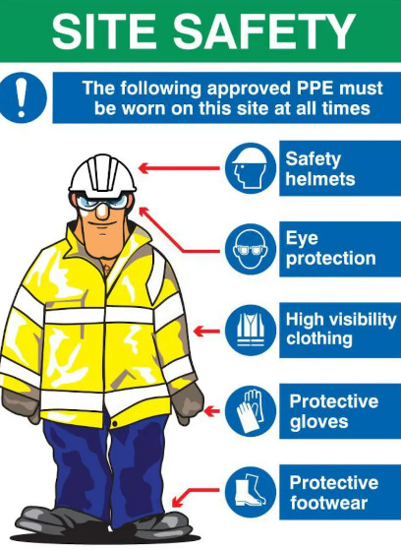
Required PPE
Your representative will guide you on the required PPE for that areas of the site you are visiting. You are required to wear and use these items.
Notes:
If this slide doesn’t have a lot of copy use the alternative layout option that has a graphic element on the bottom right corner.

Slide 11
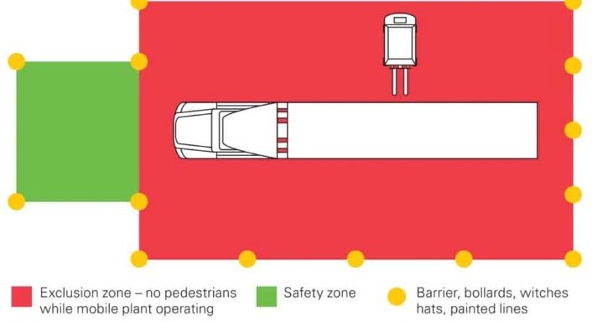
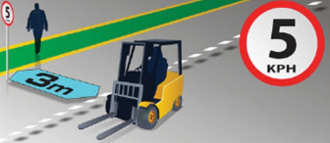
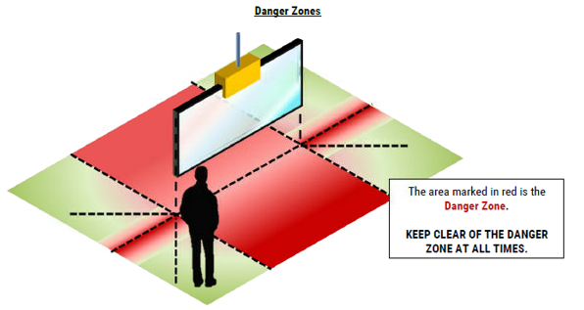
Exclusion Zones and Mobile Plant
Exclusion zones must be maintained
This includes loading and unloading areas, crane operations and mobile plant
You must not enter these areas without approval from the operator.
Notes:
If this slide doesn’t have a lot of copy use the alternative layout option that has a graphic element on the bottom right corner.

Slide 12
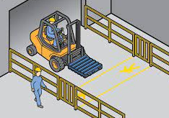
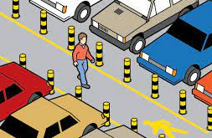
Traffic Management
Speed limits on site are:
10km/h within the Car Park & Roadways
5km/h inside
Be aware of Trucks, Forklift & Pedestrians. There are designated walkways that your representative will lead you on. You must stay on them unless directed.
Notes:
If this slide doesn’t have a lot of copy use the alternative layout option that has a graphic element on the bottom right corner.

Slide 13
Automated Machinery
Please be aware there is automated machinery operating. This machinery will operate without an operator. Do not bypass fencing and guarding. Do not interact with the machinery unless your representative directs this
Notes:
If this slide doesn’t have a lot of copy use the alternative layout option that has a graphic element on the bottom right corner.

Slide 14
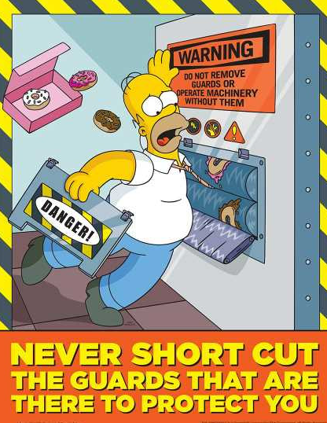
Machine Guarding
Do not override, alter or bypass a safety system or remove any guarding.
They are there to protect you and bypassing them can result in serious injury or death. Potential hazards are pinch points, impact, entanglement and crushing
Notes:
If this slide doesn’t have a lot of copy use the alternative layout option that has a graphic element on the bottom right corner.

Slide 15
Electrical Safety & LOTO
Do not touch electrical machinery or services. If a machine is locked out or tagged out you must not touch it or remove the LOTO
Notes:
If this slide doesn’t have a lot of copy use the alternative layout option that has a graphic element on the bottom right corner.

Slide 16
Chemicals
Chemicals at site can be dangerous and cause serious injuries. You must not touch or expose yourself to any chemical unless your representative instructs. Assume all chemicals are dangerous
Notes:
If this slide doesn’t have a lot of copy use the alternative layout option that has a graphic element on the bottom right corner.

Slide 17
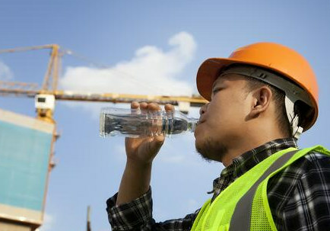
hot environment
The following safety precautions shall be taken when you are in a hot environment:
Cool drinking water is available at the site
If affected by heat cramps, which normally only occurs under the severest heat stress conditions, seek medical attention immediately. In heat stress conditions the alternatives of work rescheduling, cooling or other preventative methods shall be employed.
It is important to know the signs and symptoms of heat exposure and how you should respond. Symptoms vary according to the type of heat-related illness.
Notes:
If this slide doesn’t have a lot of copy use the alternative layout option that has a graphic element on the bottom right corner.

Slide 18
incidents
Report all injuries to your Representative as soon as reasonably possible but no more than 24 hours after incident.
Why?
Allow appropriate and prompt treatment
Facilitate an investigation to identify the cause(s) and prevent recurrence
ALL incidents must be reported and investigated to prevent recurrence, including:
Injuries and illnesses
Property damage
Fire
Theft
Dangerous Occurrence
Chemical Leaks and Spills
Near Misses (A near miss is an unplanned event not resulting in injury, illness or damage but had the potential to do so)
Incident Investigation form must be filled in by your Capral Supervisor and submitted to the Manager and Safety Department.
Notes:
If this slide doesn’t have a lot of copy use the alternative layout option that has a graphic element on the bottom right corner.

Slide 19
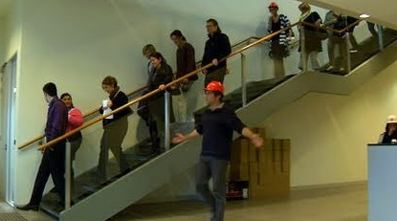
Evacuations
Please refer to you representative for the location of your evacuation point
In an emergency, please stay calm, listen and follow all instructions from your representative. If you have any medical condition or require support during an evacuation, please let your representative know straight away during the evacuation and they will assist you.
Notes:
If this slide doesn’t have a lot of copy use the alternative layout option that has a graphic element on the bottom right corner.

